Slide 1
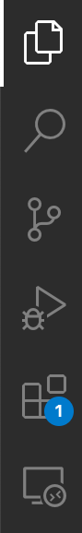
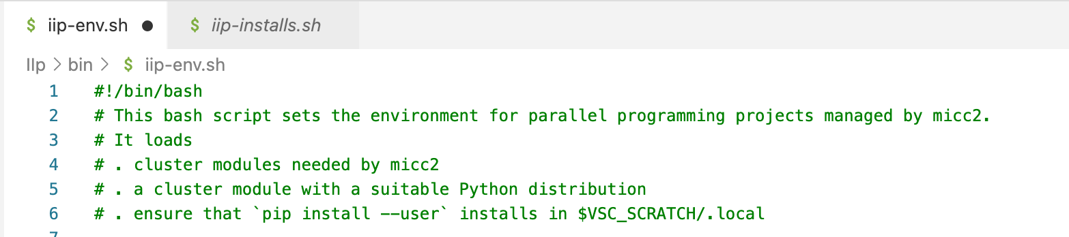
VSCode toolbar
modified
unmodified
Explorer button
Search button
Source Control button
Run and Debug button
Extensions button
Remote Explorer button

